Slide 1

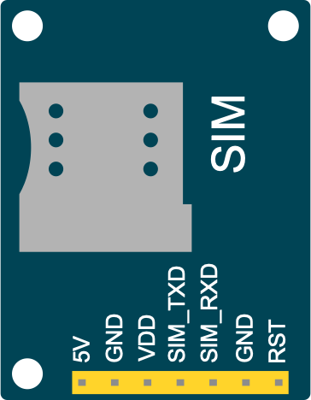
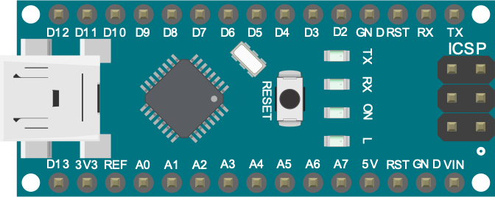
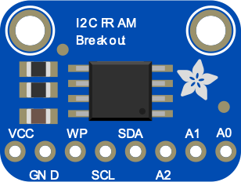
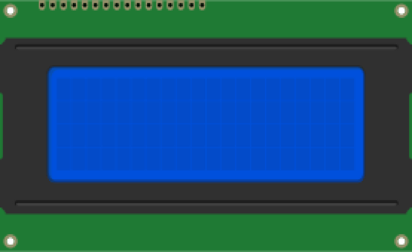




Aqua Research
Communication System for Water Disinfectant Controller
Diego Chavez, David Kirby, John Quinlan
The University of New Mexico¹, Aqua Research²
INTRODUCTION
REQUIREMENTS
ABSTRACT
Aqua Research, LLC develops innovative water treatment technologies that meet the extreme needs within developing countries and provides sustainable water purification to outdoor enthusiasts, travelers, emergency preppers, first responders, Peace Corps, and the military. Their expertise primarily resides in electrolytic technologies that produce disinfectants from salt to a variety of water filtration devices.
The use cases for these water treatment technologies call for the system to be remotely monitored. Our goal in this project was to design a communication system that could relay alerts via cellular GSM and to be able to display alert codes locally on an attached LCD and in a variety of languages.
Monitor digital and analog I/O of the disinfectant controller. This includes switch levels, indicator LEDs, and current/voltage levels.
Must have a simple and universal user interface and adaptable to a variety of languages.
Needs to be able to recover from power loss without losing state.
Needs to communicate via GSM telecommunications.
Must be cost-efficient as these devices are primarily meant for low-income and disaster areas.
Aqua Research, LLC has developed systems that use electrolysis to create chlorine from basic table salt. This chlorine can then be used as a disinfectant to create potable water.
With applications ranging from emergency response situations, third-world countries, and the military, it was imperative that end-users be able to remotely monitor and maintain these systems during less than ideal conditions. As most of the practical uses for the disinfectant systems are in difficult-to-access areas, it was also beneficial for Aqua Research to be able to troubleshoot these control systems while off-site.
For example, the team at Aqua Research have done tremendous work in Haiti following devastating earthquakes in 2010 and 2018. Being able to analyze these water treatment systems in Haiti remotely would greatly increase Aqua Research’s presence there and its ability to help more people.
The senior design group of Aqua Research set out to create a sensor system using cost-effective components that could read data from the disinfectant tanks, detect faults, and report these findings.
The device needed to be multilingual as it will be used in a variety of countries and situations; it needed to be able to recover from power loss without losing state; and it needed to be able to communicate via long-range telecommunications.
MICROCONTROLLER
CONCLUSIONS
The Aqua Research Senior Design Group went through many iterations of control boards. After analyzing a past group’s prototype using a Beagle Bone Black, we determined that we wanted to build a prototype with a newer microcontroller. We looked for one with smaller footprint and lower power consumption. Initially considering a Raspberry Pi configuration, the Raspberry Pi Zero W met our requirements for lower profile, built-in wireless, and was inexpensive. The Raspberry Pi 4 was powerful and had Wi-Fi support; however, neither of the Raspberry Pis natively supported analog inputs.
After discussing this with our Technical Mentor², it was suggested that we use the Arduino Nano as it was already implemented in other Aqua Research projects. While the last-minute change was a challenge, it proved to be the best option as it was not only less expensive but also fulfilled every requirement.
The Arduino Nano uses the ATmega328 chipset and has 32 KB of memory with 2 KB used for the bootloader. The ATmega328 has 2 KB of SRAM and 1 KB of EEPROM. Each of the 14 digital pins on the Nano can be used as an input or output and operate at 5 volts. The Nano has 8 analog inputs, each of which provide 10 bits of resolution (i.e. 1024 different values). Finally, the Nano has I2C which we used extensively for this project.
Spring 2020 was quite a semester for everyone across the globe and our Aqua Research Senior Design Group was no exception. The University of New Mexico shutting down all in-person operations, and the state and federal governments implementing social-distancing protocols meant working together on the project was quite a challenge. While it is undeniable that the coronavirus had an impact on our Senior Design project, we attempted to stay focused and driven in our pursuit of creating a communication system for Aqua Research’s water disinfectant tanks. We stayed in constant contact via text, email, teleconferencing software, and UNM’s LoboGit repository to collaborate on the code for the project. This allowed us to make considerable progress given the circumstances, all while adhering to the stay-at-home orders. We are grateful for our sponsors² and faculty¹ in helping us achieve our goals for this project. On behalf of the Aqua Research Senior Design Group, thank you!
Figure 1. GSM Breakout Board
Figure 2. I2C FRAM
Figure 3. Arduino Nano
FURTHER WORK
Figure 4. 20×4 LCD screen
Future opportunities for this project could include programming different databases to the FRAM modules so that they may be hot-swapped as needed.
We would also like to see the code optimized as even with the extended modules we were still running low on programmable memory.
Finally, we would like to extend the code and board to be able to accept various telecommunication modules. Not everywhere uses the same network and bands, and it would be ideal to support as many areas as possible. Perhaps the GSM module could be swapped out depending upon the location where the device will be used.
RESULTS
After spending the first semester understanding and setting up the sensor board used to monitor the disinfectant tank, we began the second semester creating pinout mappings for the microcontroller. Using the Arduino IDE, we broke our project down into three main modules: memory, GSM, and display.
We were successful in configuring two non-volatile memory units to be used as language databases for our sensor display. Each ferroelectric RAM, or FRAM, can store up to 32 kilobytes of information. FRAMs are comparable to dynamic random-access memory but with a ferroelectric layer instead of dielectric layer. This makes it non-volatile but with the responsiveness of dynamic RAM. The FRAMs use I2C interface and one of the challenges of this setup was in connecting the components together so that we could read and write to the modules individually. We accomplished changing FRAM addresses by driving specific individual pins high.
Next, we focused on the communication network. We opted for using a GSM (global system for mobile communication) breakout board, and though there were issues with the pins used, we were adamant to solve it. There were issues on which pins to use and how to address the board. The module is a Quad-band GSM/GPRS solution and can transmit SMS and data with low power consumption. Once we were successful in wiring it to the Arduino, we activated a SIM card and programmed the board to transmit using case statements based on our test scenarios.
Finally, our last requirement was to display the sensor feedback using a 20×4 LCD screen. This was also connected via I2C and allowed us to display user instructions and alerts. Together, these three modules allowed us to successfully complete our project, providing Aqua Research with a prototype which is now being implemented.
ACKNOWLEDGEMENTS
Dr. Ramiro Jordan, Lead Instructor; Dr. Ganesh Balakrishnan, Assistant Instructor; Bradley Evans, Teaching Assistant
Rodney Herrington, Sponsor; Tim Cushman, Technical Mentor, Lois Warren, Technical Mentor
AQUA
RESEARCH
Diego Chavez
David Kirby
John Quinlan

